Slide 1

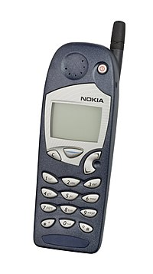
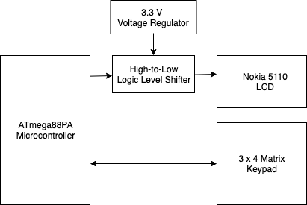
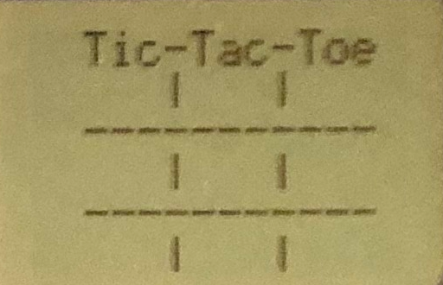
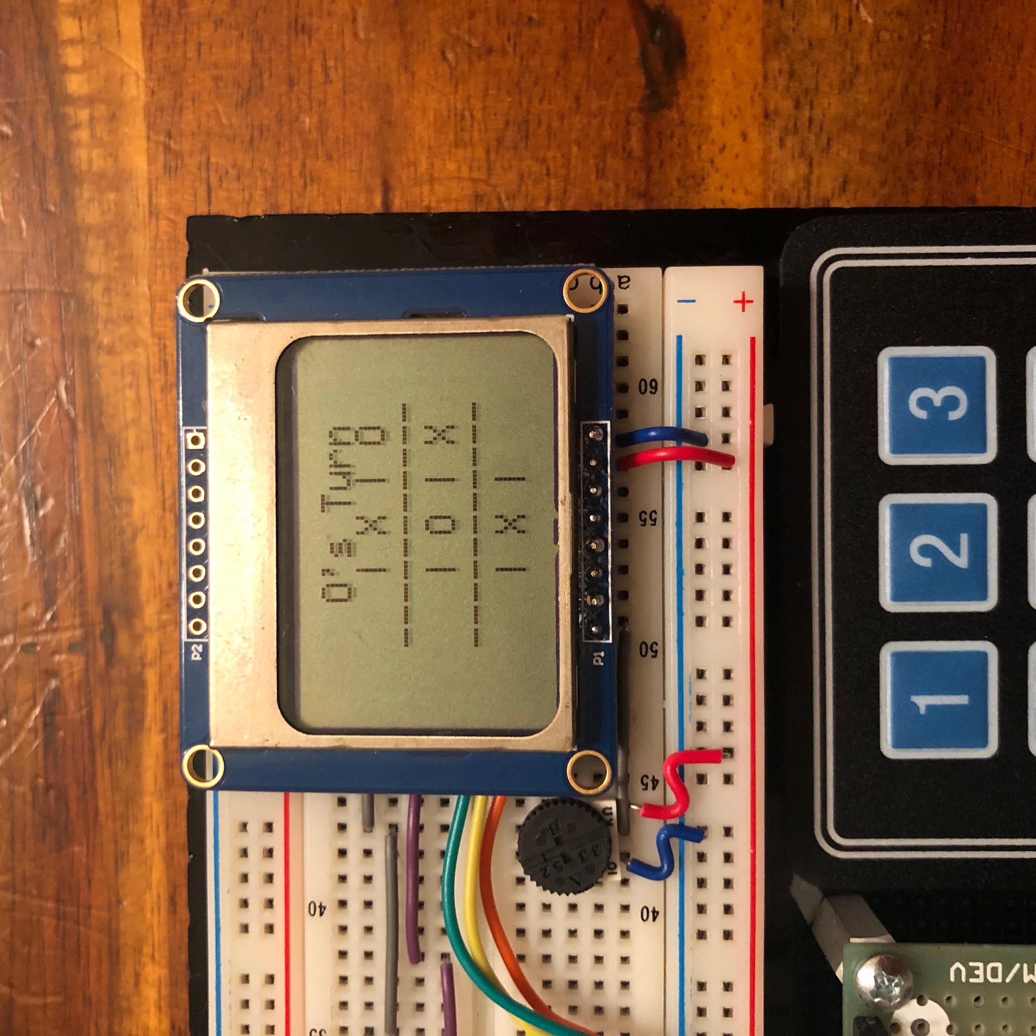
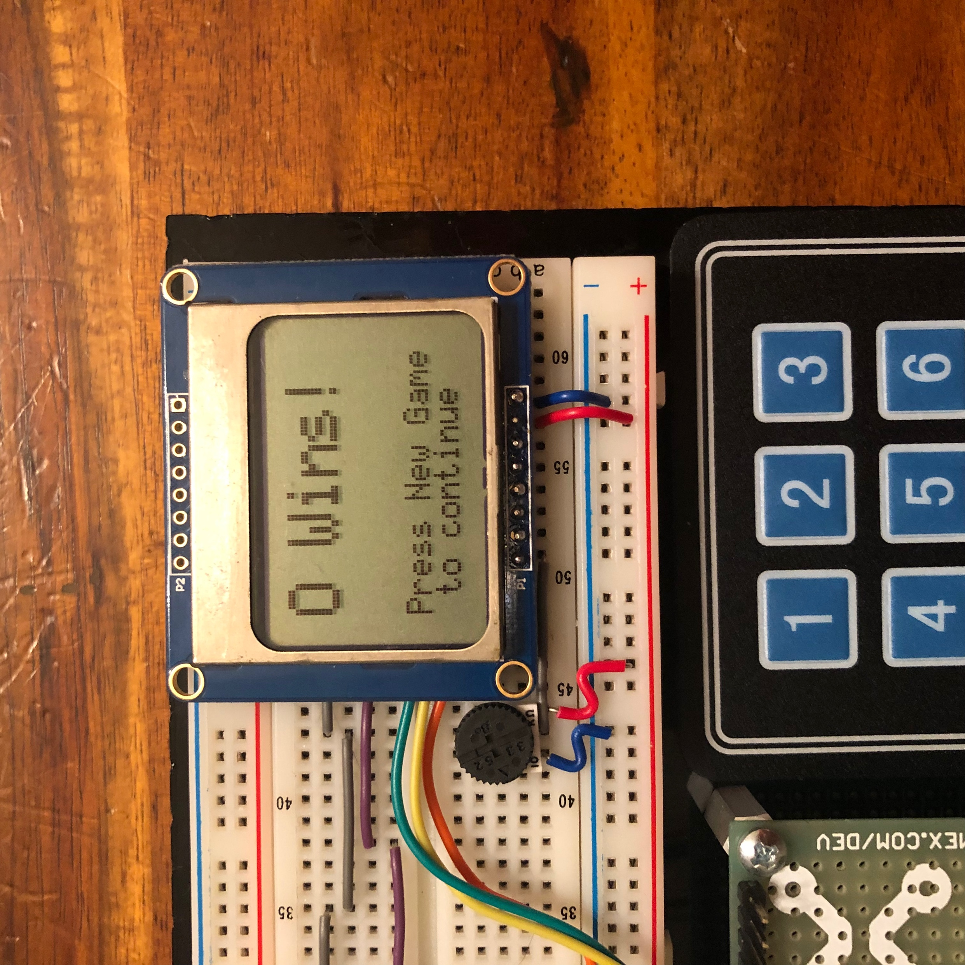
Tic-Tac-Toe Game
P 37
Team Members: Meghan McLaughlin & Dylan McNamara
Abstract
This project implements the game Tic-Tac-Toe using a Nokia 5110 cell phone LCD display. The players are able to select their token placement using an attached keypad. The LCD display will update to reflect the placed tokens if the placement was valid. If the game is won by a player, a message will be displayed and a new game will begin. The players may also choose to restart the game by pressing the ‘New Game’ button on the keypad. A potentiometer (to dim the display), voltage regulator and logic level shifter have been included in the design to interface with the LCD.
Introduction
This project was inspired by the games included on the Nokia 5110 and 3310 cell phones. The display on our final project is actually a display reclaimed from one of these phones (they really do last forever!).
We designed and implemented a simple Tic-Tac-Toe game which interfaces with a keypad reminiscent of those on the Nokia 5110/3310.
This type of game is ideal for the simple keypad interfaces and small display size.
System Description
The diagram to the left shows the major components of our system.
The ATmega88PA Microcontroller serves as the central processing unit of our system. It provides the display signals to the LCD and decodes the input signals from the keypad.
The Nokia LCD provides a graphical display for the user to view the game board and status messages.
The 3 x 4 Matrix Keypad provides an efficient interface for the user to interact with the system.
The 3.3 V Voltage Regulator, together with the High-to-Low Logic Level Shifter fulfil the crucial role of shifting the 5 V signals from the microcontroller to the 3.3 V level required by the Nokia LCD. We also included a potentiometer to allow for the LCD backlight to feature an adjustable brightness.
High-Level System Overview
Results
Our final project is able to implement all of the functionality of a Tic-Tac-Toe game with an easy-to-use user interface.
Our implementation provides the following:
Automatically switches between Player X and Player O, and displays current turn to the user.
Allows only valid token placement – a token cannot be played on a spot that is taken.
Recognizes when a game has been won, and displays the winner.
Provides the option to start a new game and reset the game board at any time.
LCD features a dimmable backlight.
Game Display
Lessons Learned
Conclusion
During project development, we were required to make a few design changes in order to complete our final product. Initially, we planned to use a pair of Infrared Remotes and IR sensors to collect user input. After some investigation into the process of decoding IR signals, we made the decision to incorporate a hard-wired keypad instead.
Additionally, we discovered some issues with the integrity of the keypad. Some keys are detected inconsistently - at times the key press is not detected at all. After some testing using a multimeter, we have determined this is an issue with the hardware component itself rather than our implementation.
We were able to successfully implement the physical hardware and corresponding game user interface.
In the future, we may extend this project to be able to play other games (like ‘Snake’, the original game included on the Nokia 5110).
Additionally, we may attempt to find the actual Nokia hardware or a different keypad to connect to the ATmega88PA microcontroller.
Acknowledgements
Nokia LCD Library: github.com/ss2222/AVR-nokia-5110
ECE:3360 Embedded Systems 2019
The University of Iowa

